Slide 1
TreeLOG
PUMA Team
CSIT 551
Montclair State University

Slide 2
Team Puma
Moaath Alrajab | Instructor
Members of the PUMA team Team member in alphebatical order
Eliezer Epstein | Classes and methods to work with Google Maps and coordinates, related UI
Elion Limanaj | DB DAO's, user Auth, Auth related UI, location detection
Inga Gaidukova | UI, classes and methods for UI to DB integration, user Auth
Supriya Karambe | Classes and methods to work with Photos, related UI, DB DAO's
Zahid Aziz | DB DAO's, user Auth, Auth related UI

Slide 3
Statement of the Problem[1]
Part 1
Initial Need
The city of Camden is looking to improve the quality of its street tree inventory. A more efficient way to survey and get baseline data on street trees would better manage risk and the health and growth of its canopy. Currently, volunteers carry physical spreadsheets to catalogue a street tree location, health, general size, type, potential hazards. Some of that info is then uploaded to a Google Map.
The purpose of the inventory is so that the city can receive adequate grant funds to replant certain areas and neighborhoods. The city should have a coverage of 20% with trees, but currently only have 8-9% coverage. Implementing our app will greatly increase Camden’s ability to receive those grants.

Slide 4
Statement of the Problem [2]
Part 2
Insights
Conducted studies during the development process have shown that tree inventories take several different forms and can be used for varying purposes.
Types:
Specific problem inventory
Partial inventory
Complete inventory
Cover type inventory
Goals:
urban forestry program
to prioritize tree maintenance needs
to plan for the community's future
to provide a basis for the implementation of a management plan

Slide 5
Initial Data from Researching Similar Apps
Keywords: tree inventory, tree inventory app, tree hazard
Rating: all ratings
Price: paid and free
Promotion: Pay-Per-Click campaign or General catalog
Sources
AppStore
Google Play
Google Search results and AdWords

Slide 6
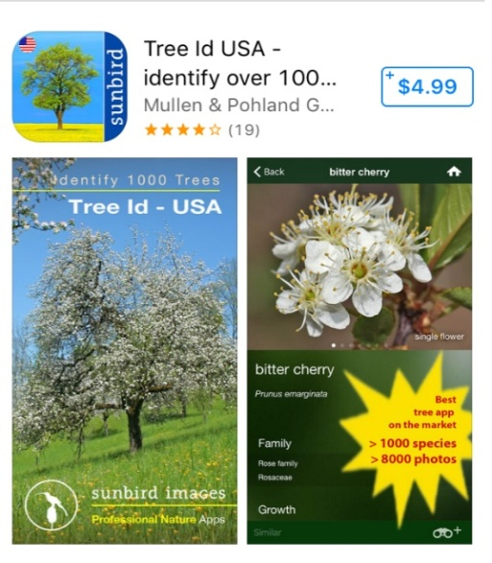
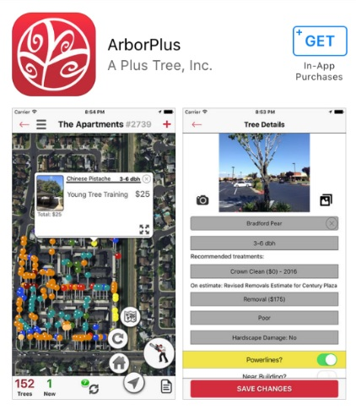
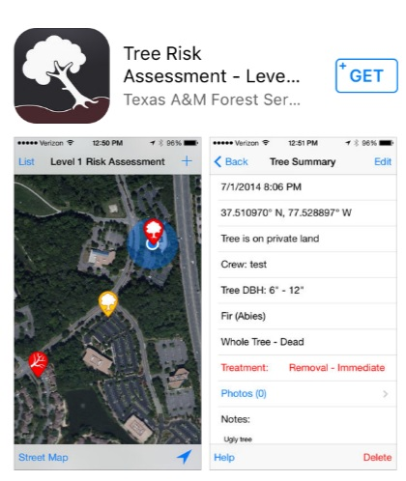
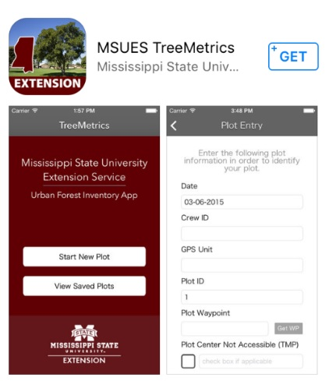
Similar apps on the AppStore
Has treatment recommendation and future alerts
Use cloud platform
Saving battery features
Well supported
Has start tour
Uses GPS technology
Tree recognition implemented using step by step instructions
Easy start to use
Integrates several established standards, such as UFORE codes (tree species list), etc
Export to CSV
For knowledgeable users
Doesn't decode the street address
Based on plot definition, not tree description, which can lead to not including street trees
Connected to GIS
Can make exports to external files
Related to inventory
Probably not supported
Questionable usability

Slide 7
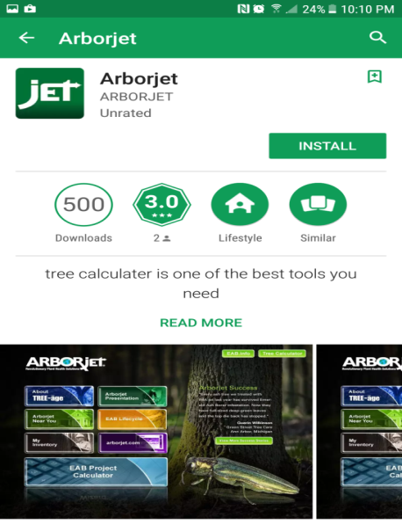
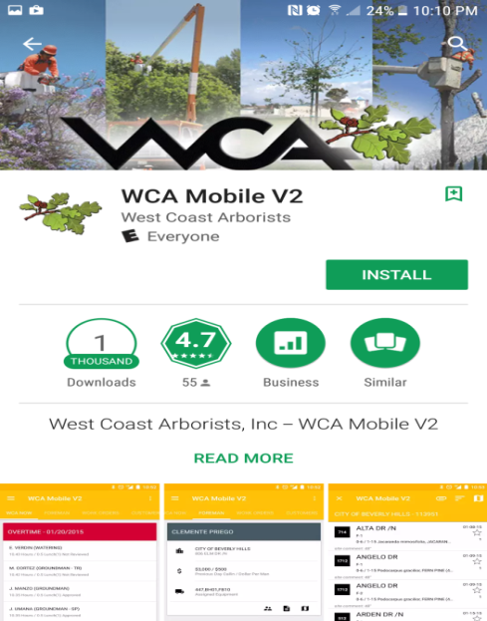
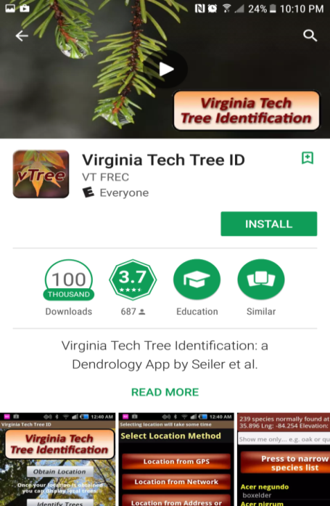
Similar apps from Google Play
Asked for managing phone calls, after denying could not configure the installation process.
Not all buttons work on the main menu
My inventory doesn't work
The application mainly works as a portal for a chemical solution for tree health
Step by step tree recognition
Database of picture takes a lot of space on Smartphone

Slide 8
Similar Apps: Google Search and Social Media Results
Organic search did not provide any links to websites where the apps could be found
No supporting pages were found on social media
Tree Inventory Applications found as a result of the PPC Campaign
Name: Tree Plotter
Price: Extremely High
Pros and Cons are not available for exploring (ships with customized configuration)

Slide 9
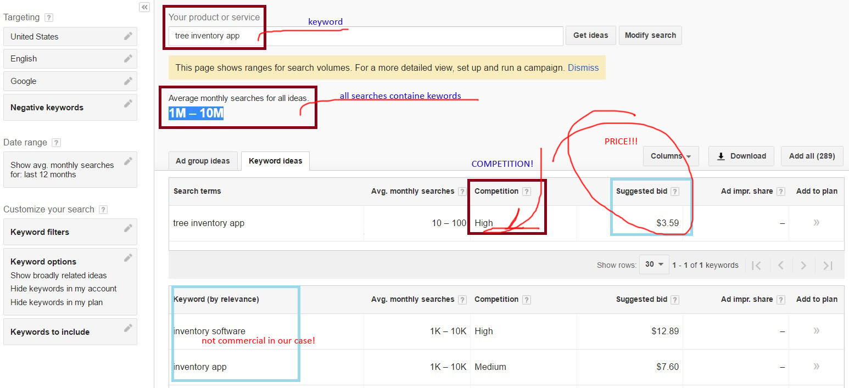
Why particular keywords and Pay-Per-Click sources

Slide 10
Initial Solution
Multi user mobile application which locates GPS coordinates in the field, allows users to save a description of the tree in the database with a photo taking option and leaf recognition capabilities for Android platform devices.

Slide 11
Initial Objectives
Function | Action
Track GPS location of the tree | Will mark the coordinates of the tree and save to the database
Photo uploading capabilities | Will use phone's camera to take pictures in the application interface with an option to save in the database
Identify hazards | Will use preset data for usability and identifying the level of hazard for future actions.
Storing all tree related data in a database | All data will be saved in a database
Login options (regular, google+) | Will allow user to login to the application

Slide 12
Functionality at the final phase and limitations according to the specification
Function | Implemented
Track GPS location of the tree | Done
Identifying type of tree | Not implemented
Photo uploading capabilities | Done
Identify hazards | Done
Storing all tree related data in a database | Done
Login options (regular, facebook, google+) | Done (regular, google, facebook partially)
Application administrator | Not implemented

Slide 13
Target Users and Audience
Initial Users
Volunteers from Sustainable Camden County Municipality, who are mapping trees, are the intended users of the application. The Application will be created for the devices with the Android platform.
Prospective Users
Small town municipalities
Departments of parks and recreation (ex. New York City Department of Parks & Recreation )
Landscape companies and designers
Golf clubs
Medical and rehabilitation centers
Large estates to maintain landscape
etc.

Slide 14
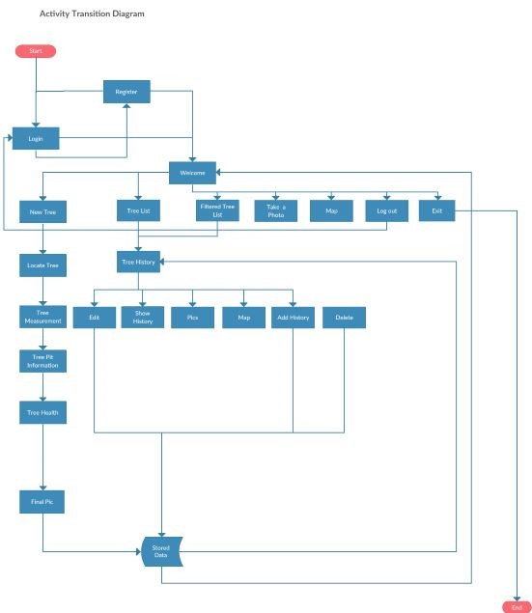
Application Workflow

Slide 15
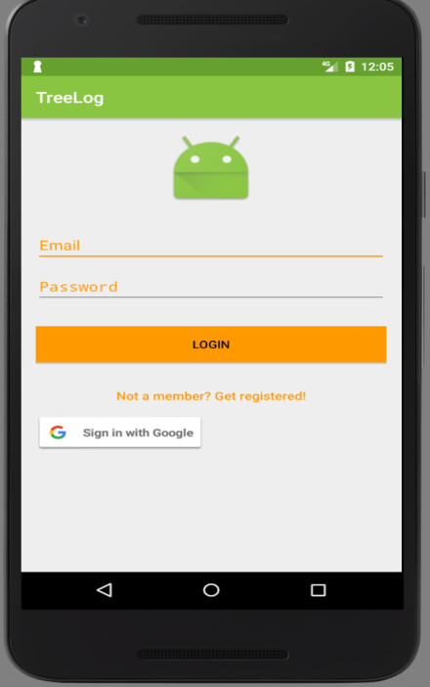
Login Activity
User Can Login Using Two Methods 1. Regular Email ID and Password(vid). 2. User can use his /her existing google id and password(vid). If the user is not already registered, he/she will be directed to the Registration Activity.

Slide 16
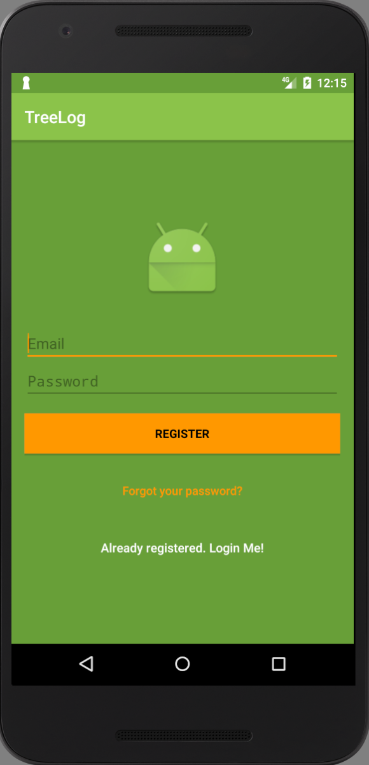
Registration Activity
 | A new user can register, using their email id and password(vid).

Slide 17
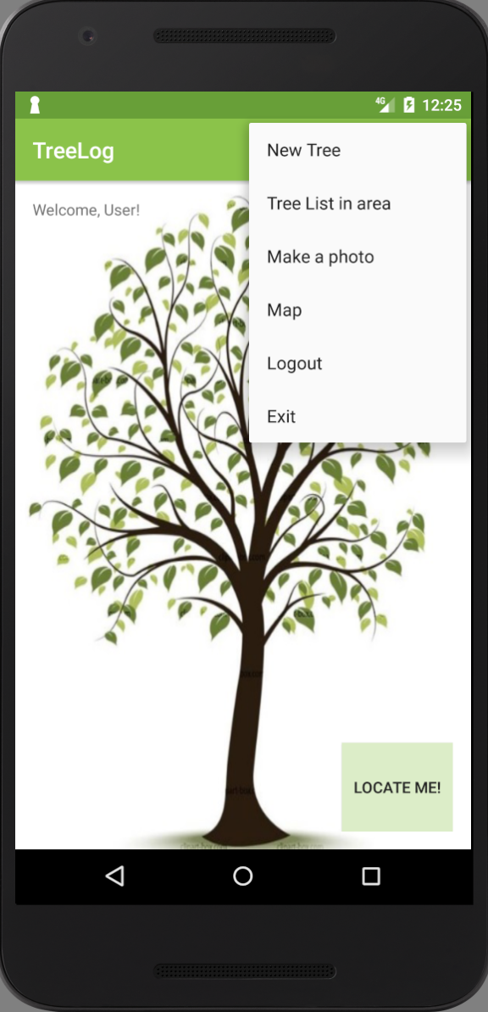
Welcome Activity
Once a user has logged in he sees the Welcome Screen. There is a menu at the top of the screen allowing the user to navigate to various activities. 1.New Tree 2.Tree List in Area 3.Make a photo 4.Map 5.Logout 6. Exit

Slide 18
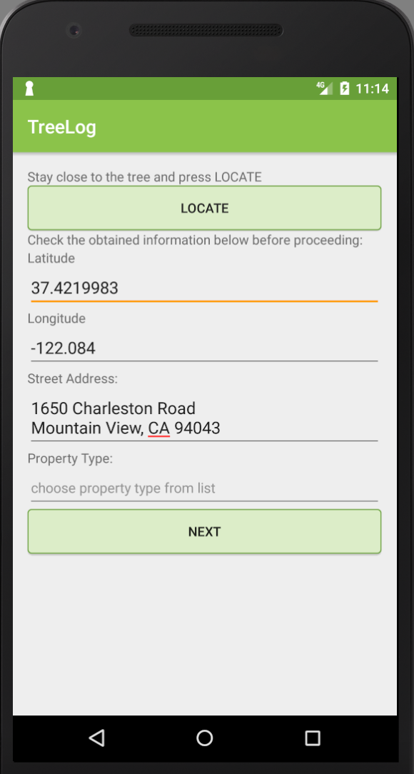
New Tree
 | A user can create new trees in the database using the New Tree activity. The “Locate” button is used to get the GPS coordinates of the user to act as a marker for the new tree. It also automatically populates the street address section with the corresponding location(vid). Or a user can manually add the latitude, longitude, and street address of the tree. The “Property Type” section refers to whether the tree is on public or private property. Continue…

Slide 19
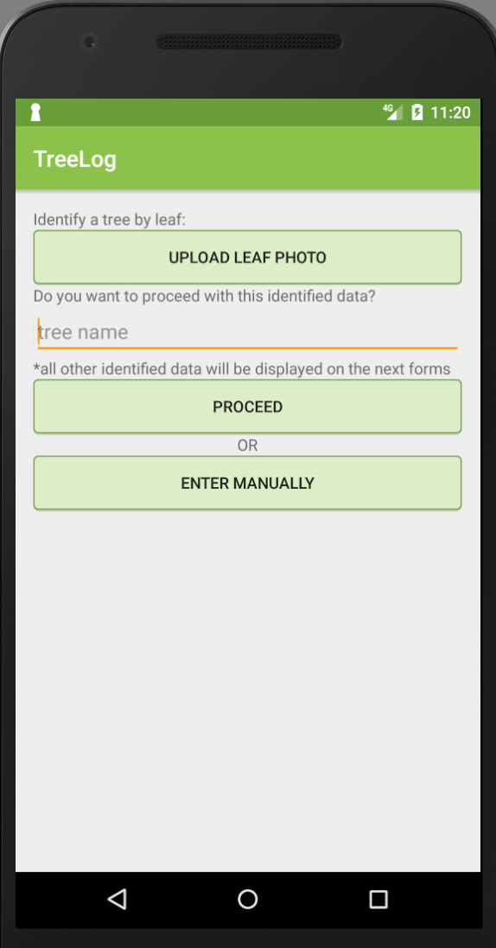
A user can give the tree a unique name. There are then two options for adding tree info - 1. A user can proceed with information fetched from the database automatically based on the tree photo (not-implemented). 2. A user can manually add info about the tree.

Slide 20
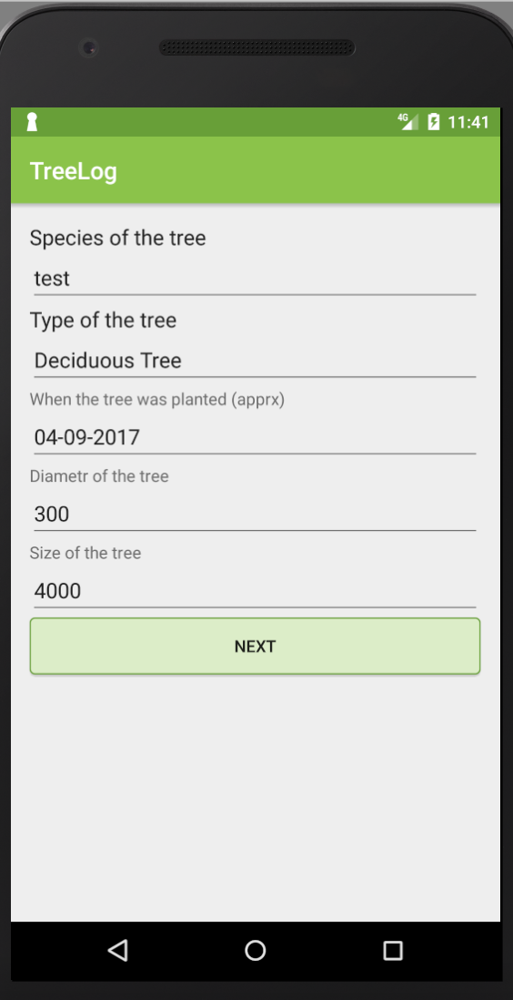
TreeData
 | Here the user enters additional information regarding the tree species, type, diameter and size.

Slide 21
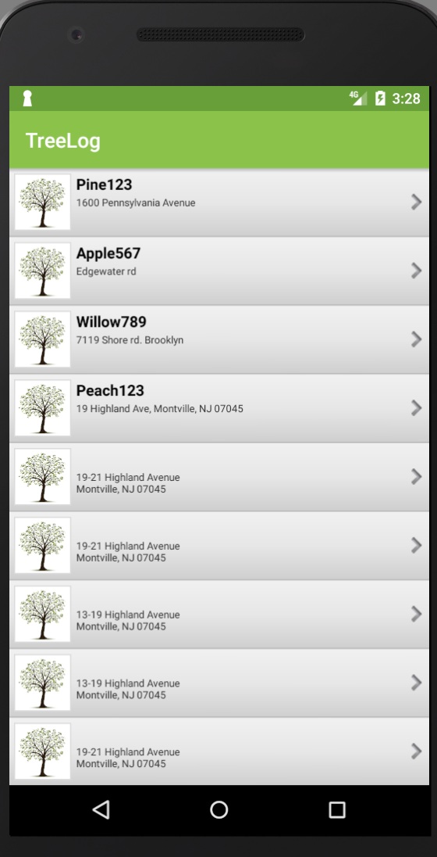
Tree List in Area
The “Tree List” is an inventory of all trees with tree names and addresses displayed. Users can click on a particular tree and view its history, edit it, delete it, or view its location on a map(vid).

Slide 22
Technology Used
Android Studio
GithHub
Firebase Database
Google Play Services (Google Location, Google Maps)
Google Play Developer Console

Slide 23
Firebase Database
Faced Problems
Few issues
Setting up read and write rules
Lessons learned
Organizational planning for future updates

Slide 24
Google Authentication
Faced Problems
Authentication with GoogleApi
General error in Google login
Lessons learned
Switched to Google provider authentication
Fingerprints need to be added to Firebase console
Signed .apk certificates fingerprint needs to be added as well

Slide 25
Google Location
Faced Problems
LocationServices inconsistently returns the user’s GPS coordinates, sometimes being off by several blocks
Geocoder returns inaccurate street address info on occasion
Lessons learned
Need to request user permission at runtime for location if not previously allowed
Implement GeoCoder for fetching addresses (and reverse geocoding)
LocationRequest added every 10 sec

Slide 26
Google Maps
Faced Problems
Map not loading due to incorrect API key
Repeated values/locations on map
Users can lose track of current position/no boundary enforced
Lessons learned
Correct referencing of need keys/values
Implement Geofencing for map boundaries

Slide 27
Google Play Developer Console
Faced Problems
No designer skill
com.example* packages names are restricted
not able to update already posted .apk with different fingerprints
Lessons learned
Generating a signed APK
General experience
Some designer skill :)

Slide 28
Images
Faced Problems
Selecting multiple images from the gallery using an intent is possible for Android API level 18 or higher only.
If the API level is less than 18 then a Custom Gallery needs to be created
Lessons learned
Use of intent to select and upload multiple images.
Use of Firebase storage to store multiple images for one object.

Slide 29
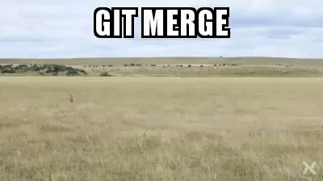
GitHub

Slide 30
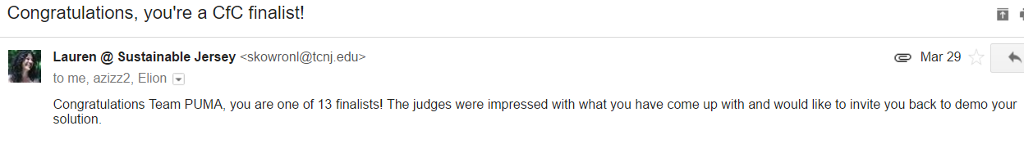
Achievements
Coding for Community Competition 2017
After the presentation of the idea of the project in the first round, our team became one of the thirteen finalists among thirty participants.

Slide 31
Short Term Perspectives
User interface improvement, such as integration with existing databases of species in North America and step-by-step tree recognition from the database.
User interface improvement by adding a tutorial on how to use the application and glossary.
Integration with binominal nomenclature (formal system of naming species of living things by giving each a name composed of two parts, both of which use Latin grammatical forms)
Classification of all types of damage (biotic or abiotic) and creation of different levels of awareness for treatment suggestions or immediate removal
Export data to *.csv file for client's needs/analysis
Build iOS version of TreeLOG application

Slide 32
Long Term Perspectives
Integration with Tree Planting Standards. This document includes design requirements, plan pest control requirements, materials, planting specifications, and seasonal maintenance requirements. By integrating all the standards with different levels of awareness we will get a full inventory with prioritized suggestions for tree maintenance.
Approximated costs or a particular contractor's cost for the different types of maintenance could be added into the application. Integration with obtained inventory with prioritized suggestions will improve budget management.
Integration with existing client's database.
More comprehensive user interface using image processing algorithms not only for species recognition but shape, size, distance in between trees, etc.

Slide 33
Plan for the Promotion
Online promotion • Distribution of the application in the AppStore for free in basic configuration • Distribution of the application on Google Play in basic configuration • Supporting website • Supporting social media page on Facebook • PPC Adwords advertising campaign Offline promotion* • Creating a marketing plan for presenting the app for 12 months to attend all events in the area related to environmental issues, communities and municipality budget discussions, inventory software development expos etc.
*After a marketing plan is calculated it will be possible to develop an exit strategy

Slide 34
Why promote our product?
What we already have:
An amazing team with very proactive people
Success in competition
Demand
Target Market
Short Term Prospective
Long Term Prospective
Plan for promotion
DEMO

Slide 35
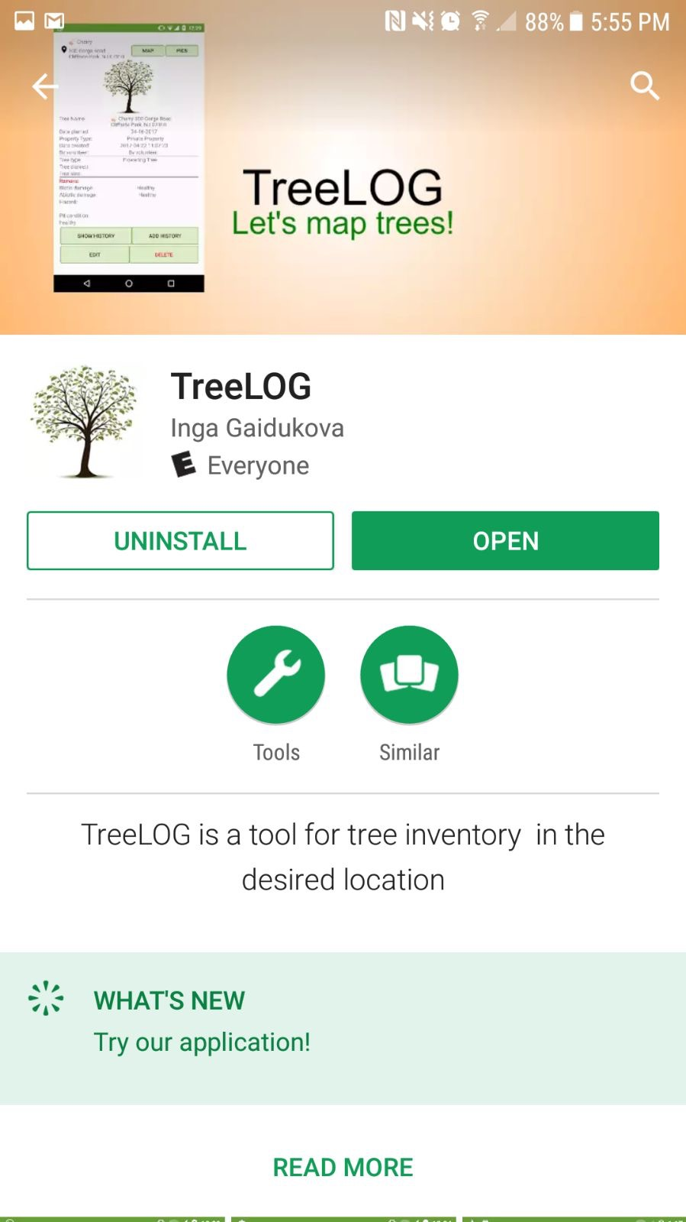
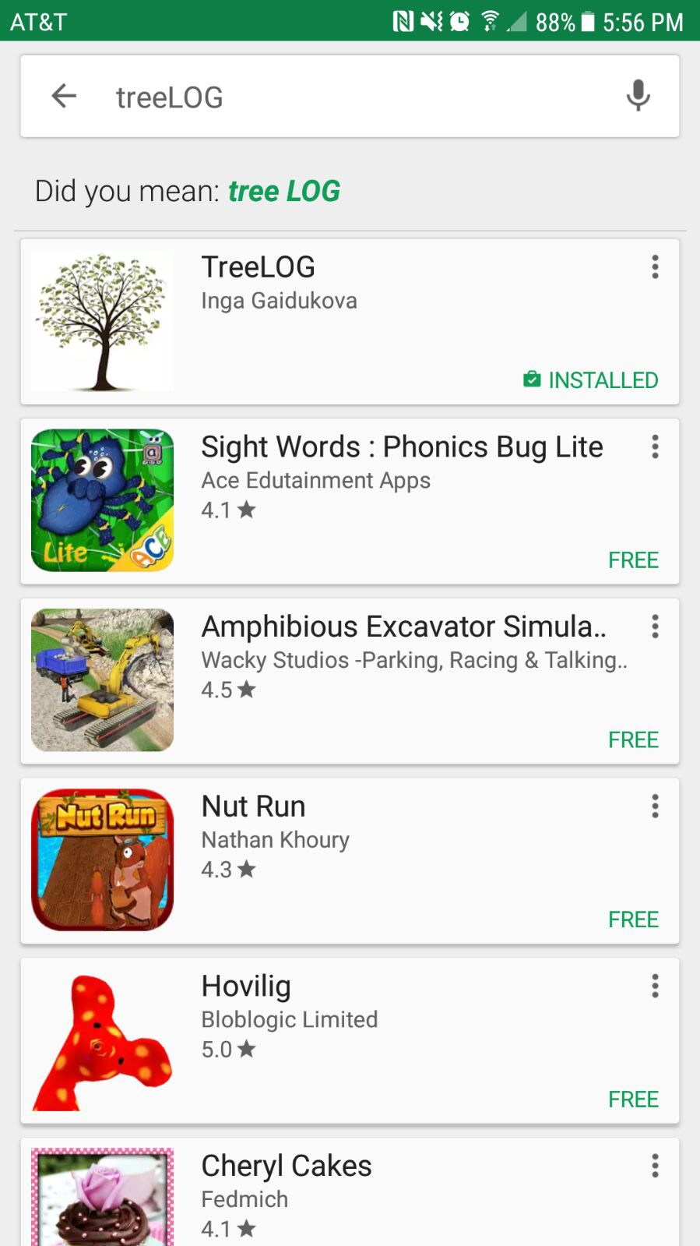
TreeLOG on Google Play
TreeLOG DEMO on Google Play here:
Install and Enjoy!

Slide 36
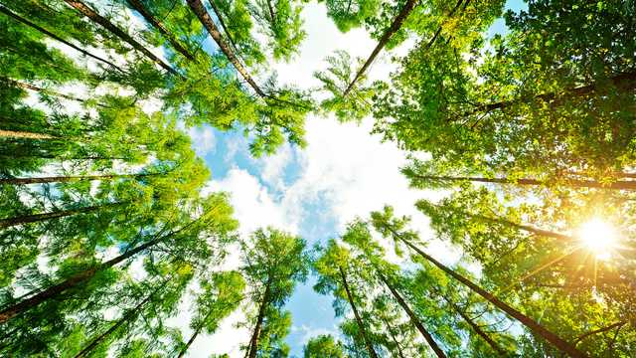
THANK YOU!

